Slide 1
Finding a Comfortable Living Area in Manhattan, NY
Sandip Pattanayak
06th December, 2019
REPORT CONTENT
1. Introduction Section:
1.1 Discussion of the "background situation" leading to the problem at hand:
1.2 Problem to be resolved
1.3 Audience for this project.
2. Data Section:
2.1 Data of Current Situation (current residence place)
2.2 Data required to resolve the problem
2.3 Data sources and data manipulation
3. Methodology section:
3.1 Process steps and strategy to resolve the problem
3.2 Data Science Methods, machine learning, mapping tools and exploratory data analysis.
4. Results section
Discussion of the results and how they help to take a decision.
5. Discussion section
Elaboration and discussion on any observations and/or recommendations for improvement.
Conclusion section
Decision taken and Report Conclusion

Slide 2
1. Introduction
Background:
I am a Learner data scientist residing in India. I currently live in Kolkata under the state West Bengal with my friend Sumit and we enjoy many amenities and venues in the area, such as various cousine restaurants, cafes, food shops and entertainment. Sumit has been offered a great opportunity to work in Manhattan, NY. Although, He is a bit stressed about a comfortable place to live in Manhattan. Therefore, I decided to apply the learned skills during the Coursera course to explore ways to make sure my decision is factual and rewarding. Of course, there are alternatives to achieve the answer using available Google and Social media tools, but it rewarding doing it myself with learned tools
Business Problem:
The challenge to resolve is being able to find a rental apartment unit in Manhattan NY that offers similar characteristics and benefits to my current situation. Therefore, in order to set a basis for comparison, I want to find a rental unit subject to the following conditions:
1. Apartment with min 2 bedrooms with monthly rent not to exceed US$7000/month
2. Unit located within walking distance (<=1.0 mile, 1.6 km) from a subway metro station in Manhattan
3. Area with amenities and venues similar to the ones described for current location As a reference, I have included a map of venues near current residence.
Interested Audience
I believe this is a relevant challenge with valid questions for anyone moving to other large city in US, EU or Asia. The same methodology can be applied in accordance to demands as applicable. This case is also applicable for anyone interested in exploring starting or locating a new business in any city. Lastly, it can also serve as a good practical exercise to develop Data Science skills.
2. Data Section:
Description of the data and its sources that will be used to solve the problem
2.1 Data of Current Situation
I currently reside in the Park Street area of Kolkata in India. I use Foursquare to identify the venues around the area of residence which are then shown in the India map shown in methodology and execution in section 3.0. It serves as a reference for comparison with the desired future location in Manhattan NY NEAR PARK AVENUE AND 53 STRT RD.

Slide 3
2.2 Description of the Data:
The following data is required to answer the issues of the problem:
1. List of Boroughs and neighbourhoods of Manhattan with their geodata (latitude and longitude)
2. List of Subway metro stations in Manhattan with their address location
3. List of apartments for rent in Manhattan area with their addresses and price
4. Preferably, a list of apartment for rent with additional information, such as price, address, area, # of beds, etc.
5. Venues for each Manhattan neighbourhood ( than can be clustered)
6. Venues for subway metro stations, as needed
2.3 Data required to resolve the problem
In order to make a good choice of a similar apartment in Manhattan NY, the following data is required: List/Information on neighbourhoods form Manhattan with their Geodata (latitude and longitude. List/Information about the subway metro stations in Manhattan with geodata. Listed apartments for rent in Manhattan area with descriptions (how many beds, price, location, address) Venues and amenities in the Manhattan neighbourhoods (e.g. top 10) 2.3 sources and manipulation the list of Manhattan neighbourhoods is worked out during LAB exercise during the course. A csv file was created which will be read in order to create a data frame and its mapping. The csv file 'mhtn_data.csv' has the following below data structure. The file will be directly read to the Jupiter Notebook for convenience and space savings. The clustering of neighbourhoods and mapping will be shown however. An algorithm was used to determine the geodata from Nominatim .
A list of Manhattan subway metro stops was compiled in Numbers (Apple excel) and it was completed with Wikipedia data
(https://en.wikipedia.org/wiki/List of New York City Subway stations in Manhattan) and information from NY Transit authority and Google maps
(https://www.google.com/maps/search/manhattan+subway+metro+stations/@40.7837297 ,-74.1033043,11z/data=!3m1!4b1) for a final consolidated list of subway stops names and their address. The geo location was obtained via an algorithm using Nominatim. Details will be shown in the execution of methodology in section 3.0. The subway csv file is ''mhtn_subway.csv'".
A list of places for rent was collected by web-browsing real estate companies in Manhattan. A csv file was compiled with the rental place that indicated: areas of Manhattan, address, number of beds, area and monthly rental price. An algorithm was used to create all the geodata using Nominatim, as shown in section 3.0. With the use of geolocator = Nominatim() , it was possible to determine the latitude and longitude for the subway metro locations as well as for the geodata for each rental place listed. The loop algorithms used are shown in the execution of data in section 3.0 "Great circle" function from geolocator was used to calculate distances between two points, as in the case to

Slide 4
calculate average rent price for units around each subway station and at 1.6 km radius. Foursquare is used to find the avenues at Manhattan neighbourhoods in general and a cluster is created to later be able to search for the venues depending of the location shown.
2.4 How the data will be used to solve the problem
The data will be used as follows:
Use Foursquare and geopy data to map top 10 venues for all Manhattan neighbourhoods and clustered in groups (as per Course LAB) Use foursquare and geopy data to map the location of subway metro stations, separately and on top of the above clustered map in order to be able to identify the venues and amenities near each metro station, or explore each subway location separately Use Foursquare and geopy data to map the location of rental places, in some form, linked to the subway locations. Create a map that depicts, for instance, the average rental price per square ft., around a radius of 1.0 mile (1.6 km) around each subway station - or a similar metrics. I will be able to quickly point to the popups to know the relative price per subway area. Addresses from rental locations will be converted to geodata ( lat, long) using Geopy-distance and Nominatim. Data will be searched in open data sources if available, from real estate sites if open to reading, libraries or other government agencies such as Metro New York MTA, etc. The processing of these DATA will allow to answer the key questions to make a decision:
2.5 Mapping of Data
The following maps were created to facilitate the analysis and the choice of the palace to live. Manhattan map of Neighbourhoods Manhattan subway metro locations Manhattan map of places for rent Manhattan map of clustered venues and neighbourhoods combined maps of Manhattan rent places with subway locations combined maps of Manhattan rent places with subway locations and venues clusters
3. Methodology section:
This section represents the main component of the report where the data is gathered, prepared for analysis. The tools described are used here and the Notebook cells indicates the execution of steps.
The analysis and the strategy:
The strategy is based on mapping the above described data in section 2.0, in order to facilitate the choice of at least two candidate places for rent. The choice is made based on the demands imposed: location near a subway, rental price and similar venues to Singapore. This visual approach and maps with popups labels allow quick identification of location, price and feature, thus making the selection very easy.
The processing of these DATA and its mapping will allow to answer the key questions to make a decision:
1. What is the cost of available rental places that meet the demands?
2. What is the cost of rent around a mile radius from each subway metro station?
3. What is the area of Manhattan with best rental pricing that meets criteria established?
4. What is the distance from work place (Park Ave and 53 rd. St) and the tentative future rental home?
5. What are the venues of the two best places to live? How the prices compare?
6. How venues distribute among Manhattan neighbourhoods and around metro stations?
7. Are there trade-offs between size and price and location?
8. Any other interesting statistical data findings of the real estate and overall data.

Slide 5
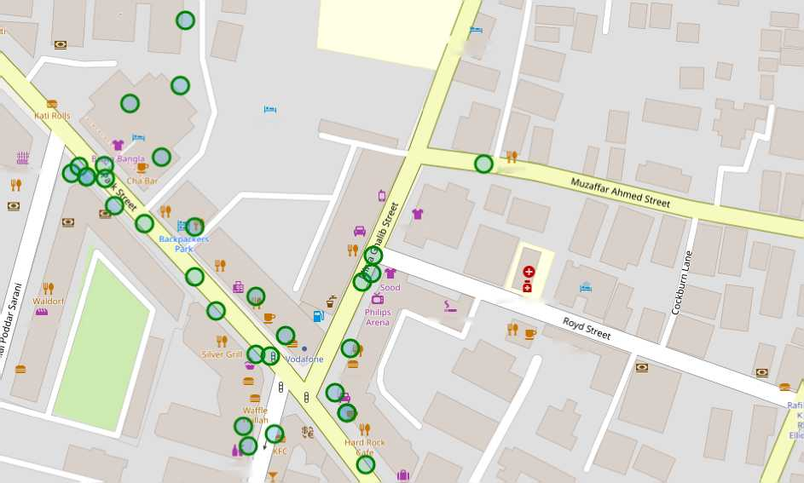
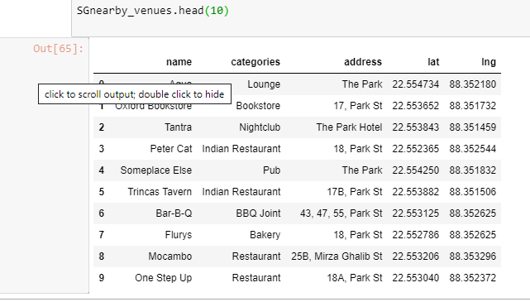
4. Execution and Results
4.1 Current Residence neighbourhood in Kolkata
Apeejay
House
' HjotelviP International
Bengal
Masonic
Lodge
Perfection
Arsalan
Westside
CNK
Tower
Patisserie
Queens
Mansion
MD Mustaq
Royd Pharmacy
Jewish Girls' School
Subway,
Baskin'
RobbiiVs
4.2 Venues around Neighbourhood

Slide 6
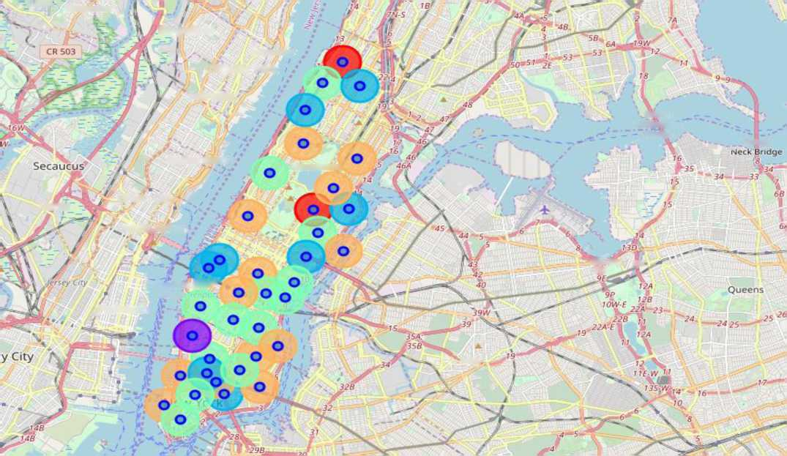
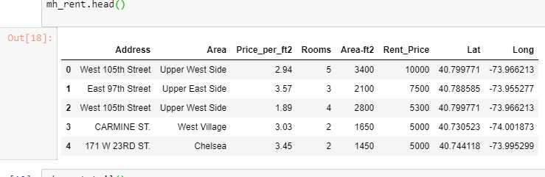
4.3 Manhattan map- venue and cluster of Venues
popups allow to identify each neighbourhood and the cluster of venues around it in order to proceed to examine in more detail in the next cel
A.'pori_ _{Moonac}f,_{ie}
Ridgefield
Edgewater
Cliffside Park
Fairview
Bronx-
Whitestone
Bridge
Guttenberg
Manhattan
Throgs
'
)6£/18E-
Union City
Weehawken
J3B-13C 13’
9IV
''XWeitlc^^
‘Street r
^Hoboken
17 W-
4.4 Geodata Manhattan Apartments for Rent

Slide 7
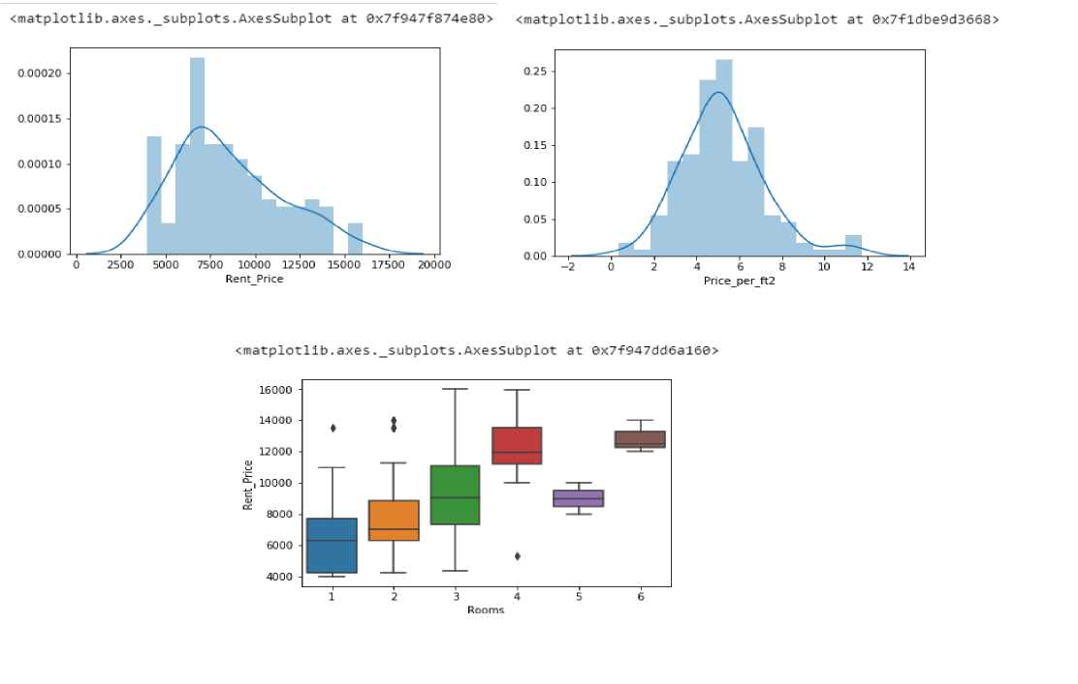
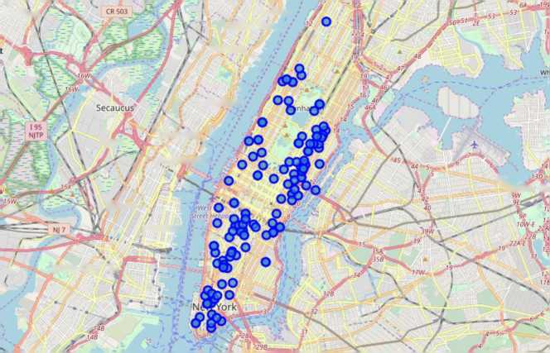
4.5 Rental Price statistics MH Apartments Budget USD 7000 / Month is around the mean
4.6 Apartment for Rents In Manhattan
jtherford
EdgeWater Cliffside Park /
Fairview
Gutteriberg
l6£/7«£_
Union City
** -^Weehawken
V ■
■13B‘1-3C ft.
Jersey City
(Hoboken
! Jersey City N,

Slide 8
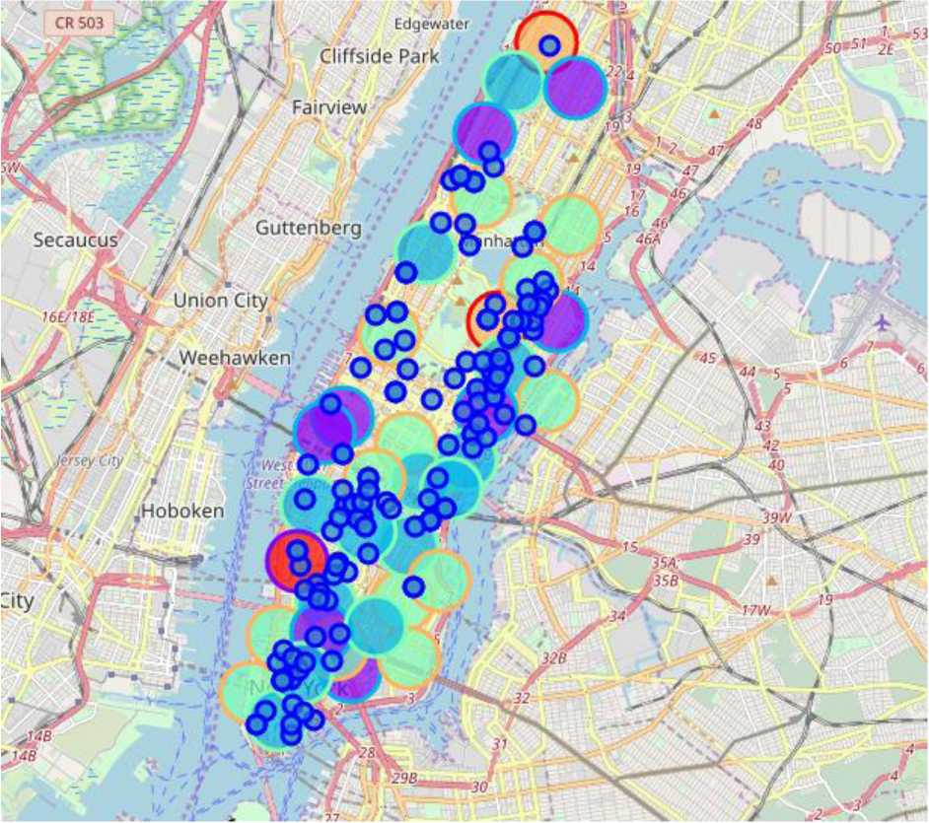
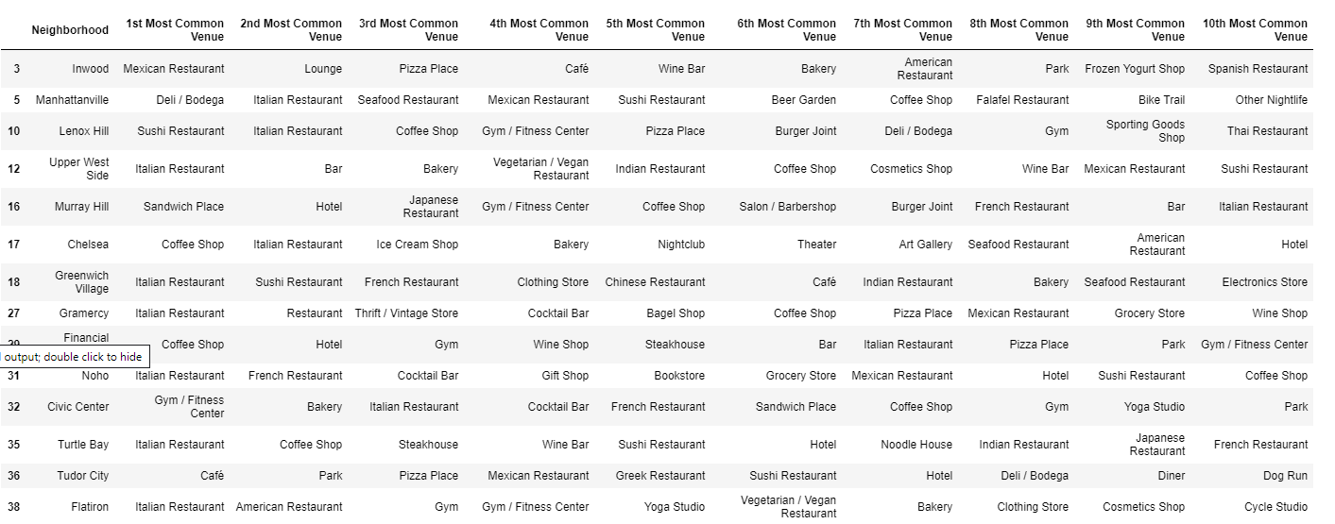
4.7 Manhattan Apts for rent with venue clusters
4.8 Venues of Cluster 3

Slide 9
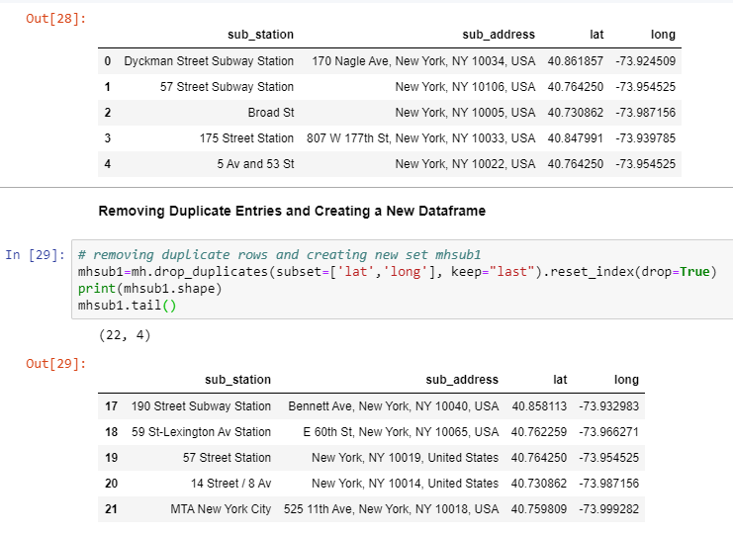
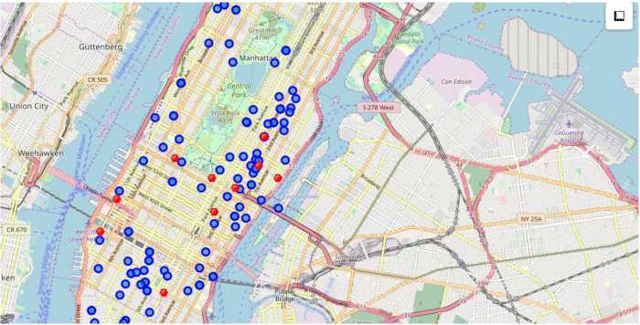
4.9 Manhattan Subway Station Geodata
sub address
at
4.10 Apt for rent (blue) and subway station (red)
Now, we can visualize the desirable rental places and their nearest subway station. Popups display rental address and monthly rental price and the subway station name.
Notice that the icon in the top-right corner is a "ruler" that allows to measure the distance from a rental place to an specific subway station

Slide 10
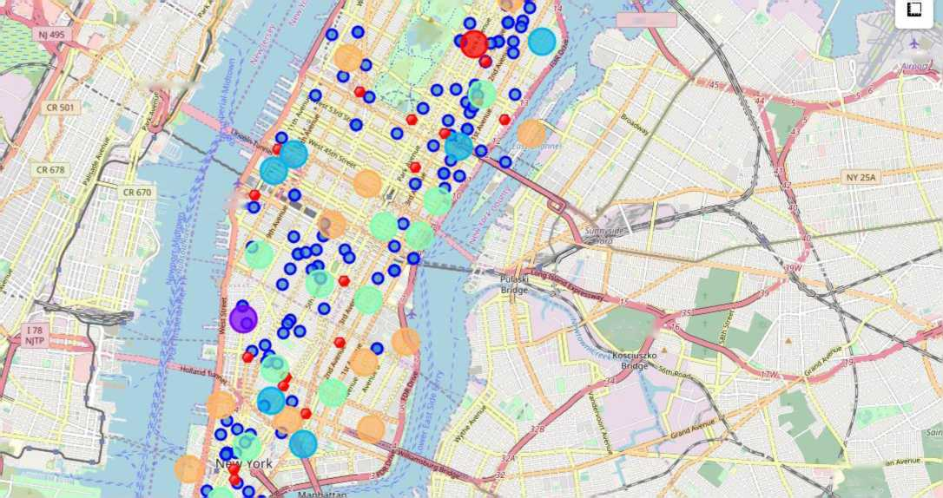
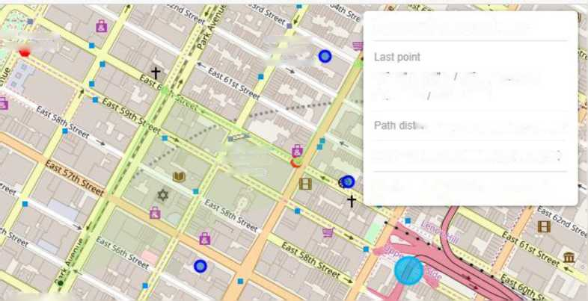
4.11 Selected apartments
The one consolidated map that shows all information for decision: Apartment address, Price, Cluster of venues and
subway station nearby.
Blue Dots = apts, Red dots = Subway stations, Bubbles = cluster
of venues
I Union City
far if-
1-278 West
■Vista Rock 40 m‘
LoGuardio
Weehawken
Weii,3i Street Het
Hoboken
Cotvary >/ \ Cemetery A⁵
*?T Metro***¹'¹ Tf
M Alt Foiths
C f.-f
'Cemetery
4.12 Apartment Selection
I feel that Cluster 2 type of venues is a closer resemblance to my current place. That means that APARTMENT 1 is a better choice since the extra monthly rent is worth the conveniences it
provides.
5th Avenue-59ti^treet
Lexington Aveinue-63rd Street
⁶ Measure distances and areas
40’ 45 36.18 N 73' 58' 19 04” VY
40 760049 -73.971956
59th Street' Lexington /"•.Avenue
ance 1.270 Meters (0.79 Miles) /
Area 129.832 Sq Meters (32.08 Acres i
. O Cancel O Finish measurement
.Midtown East'

Slide 11
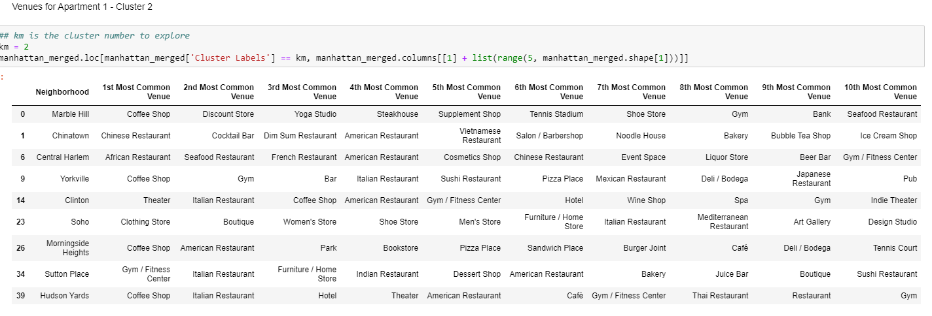
4.13 Venue is cluster 2 near Future living place
5.0 DISCUSSION
Using the "one map" above, I was able to explore all possibilities since the popups provide the information needed for a good decision.
Apartment 1 rent cost is US7500 slightly above the US7000 budget. Apt 1 is located 400 meters from subway station at 59th Street and work place ( Park Ave and 53rd) is another 600 meters way. I can walk to work place and use subway for other places around. Venues for this apt are as of Cluster 2 and it is located in a fine district in the East side of Manhattan.
Apartment 2 rent cost is US6935, just under the US7000 budget. Apt 2 is located 60 meters from subway station at Fulton Street, but I will have to ride the subway daily to work, possibly 4060 min ride. Venues for this apt are as of Cluster 3.
I feel that Cluster 2 type of venues is a closer resemblance to my current place. That means that APARTMENT 1 is a better choice since the extra monthly rent is worth the conveniences it provides.
6.0 CONCLUSIONS
This project has shown me a practical application to resolve a real situation that has impacting personal and financial impact using Data Science tools.
The mapping with Folium is a very powerful technique to consolidate information and make the analysis and decision thoroughly and with confidence. It can be utilized effectively where people who are turning to new cities to start a business or work with their comfortable living options as per their desire.

